Slide 1


Slide 2


Slide 3

Logline
WHISPER DOWN THE LANE : An experimental, animated short movie that takes us on a linear journey, following a string of interconnected phone calls between five individuals that eventually escalate to a bigger conflict.

Slide 4
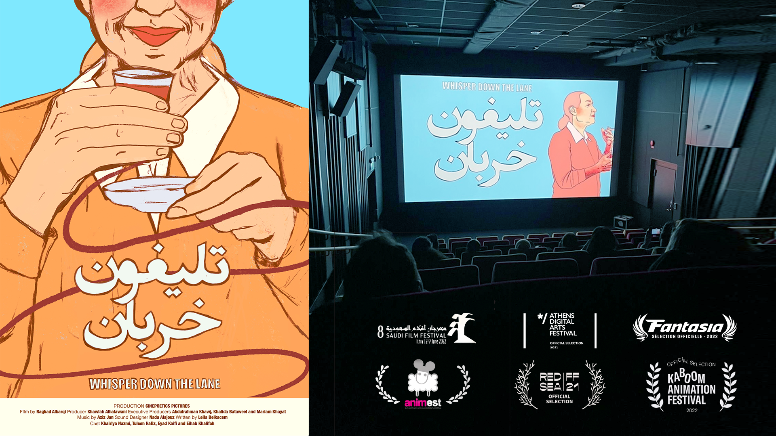

Slide 5
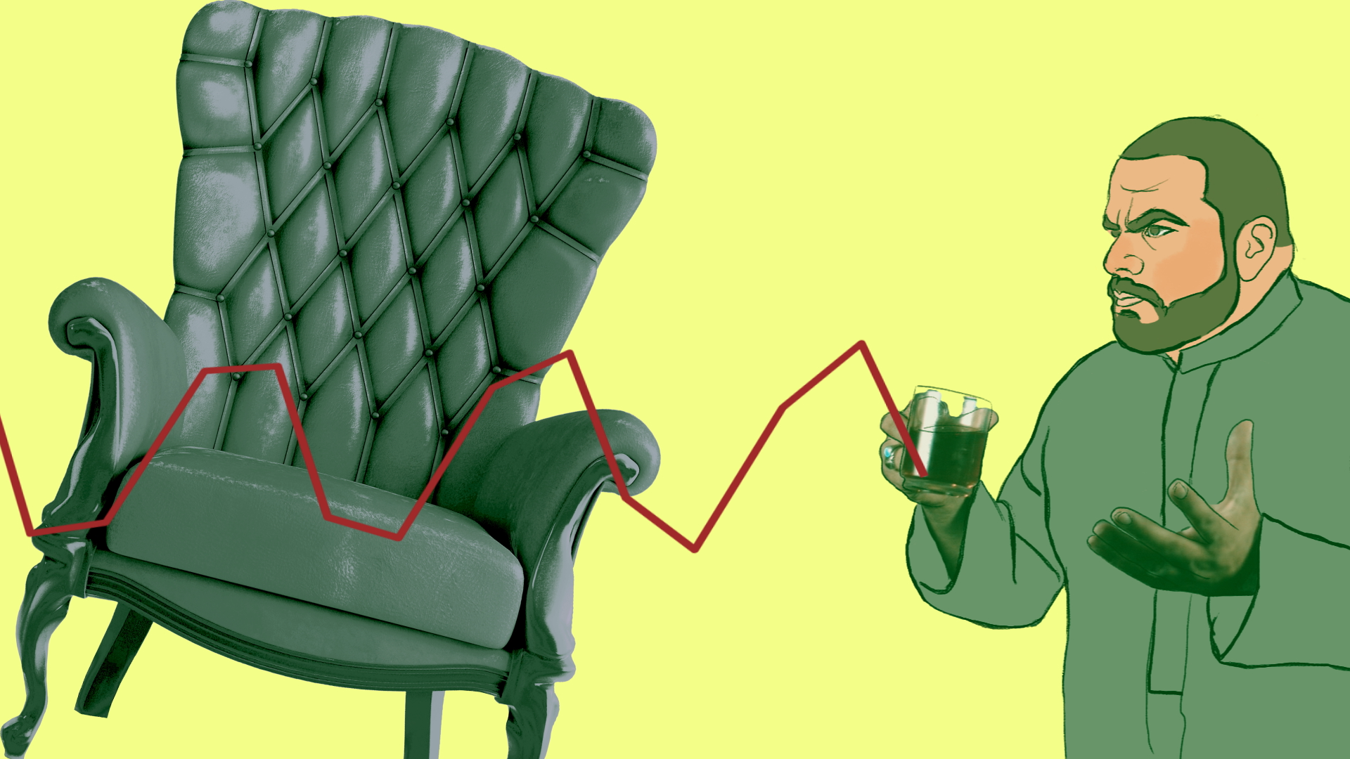
The target audience, market and USP
Genre: Animation - Experimental - Drama
Age group: 13 - 60 Years old
Industry: Art/ Entertainment - Film and Animation
Where: Film Festivals, Galleries possibly (Streaming platform)
Duration: 4:00 - 5:30 MINS
Style: 2D Animation /Mixed media

Slide 6
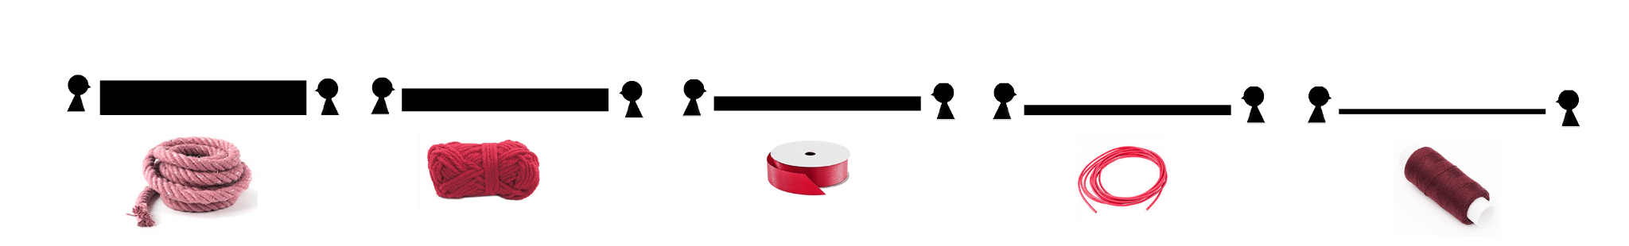
Why VR, and What will the audience Experience?
1- The use of VR can demonstrate the thickness of the threads, which resemble the relationships between each character
SCENE 1
SCENE 2
SCENE 3
Notes:
Each thread resemble a relationship so it’s very important

Slide 7
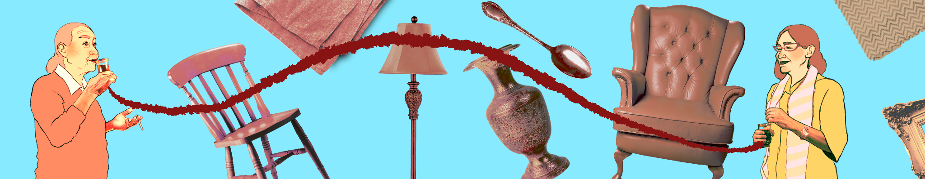
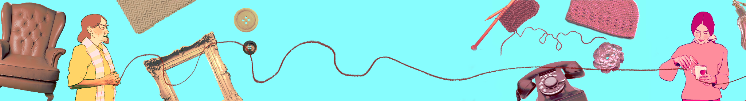
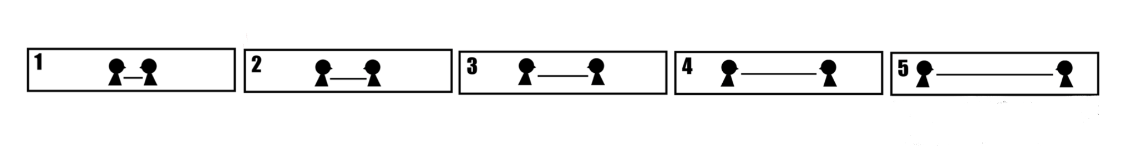
2- The use of VR clearly shows space between the characters, emphasizing their relationship Also the depth of the objects in the background.
Notes:
In good terms with each others

Slide 8
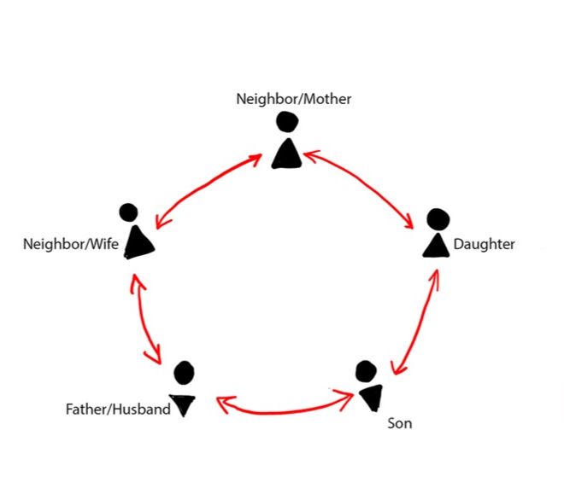
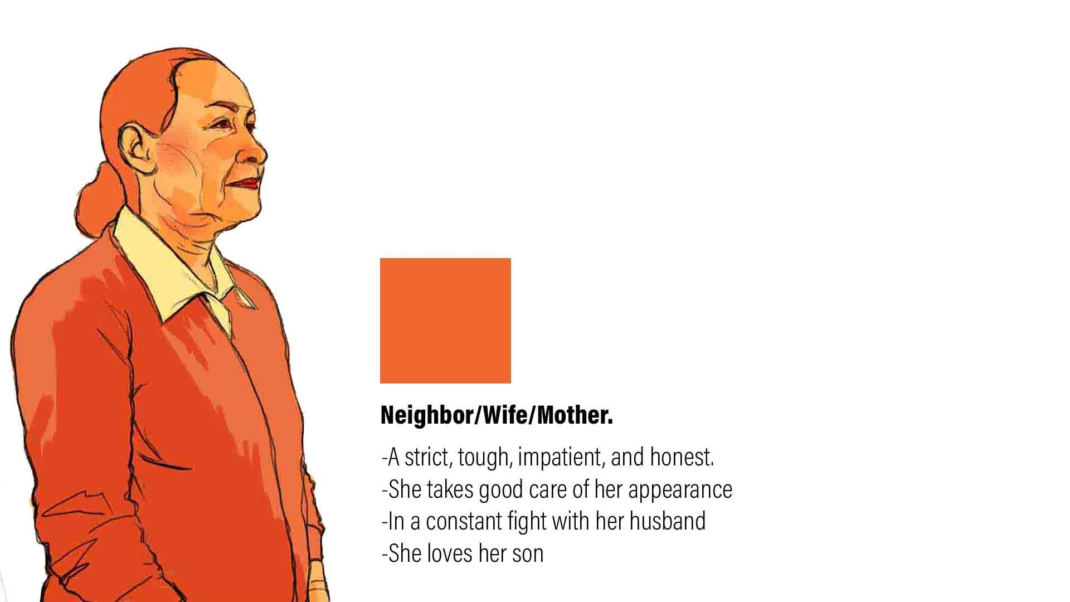
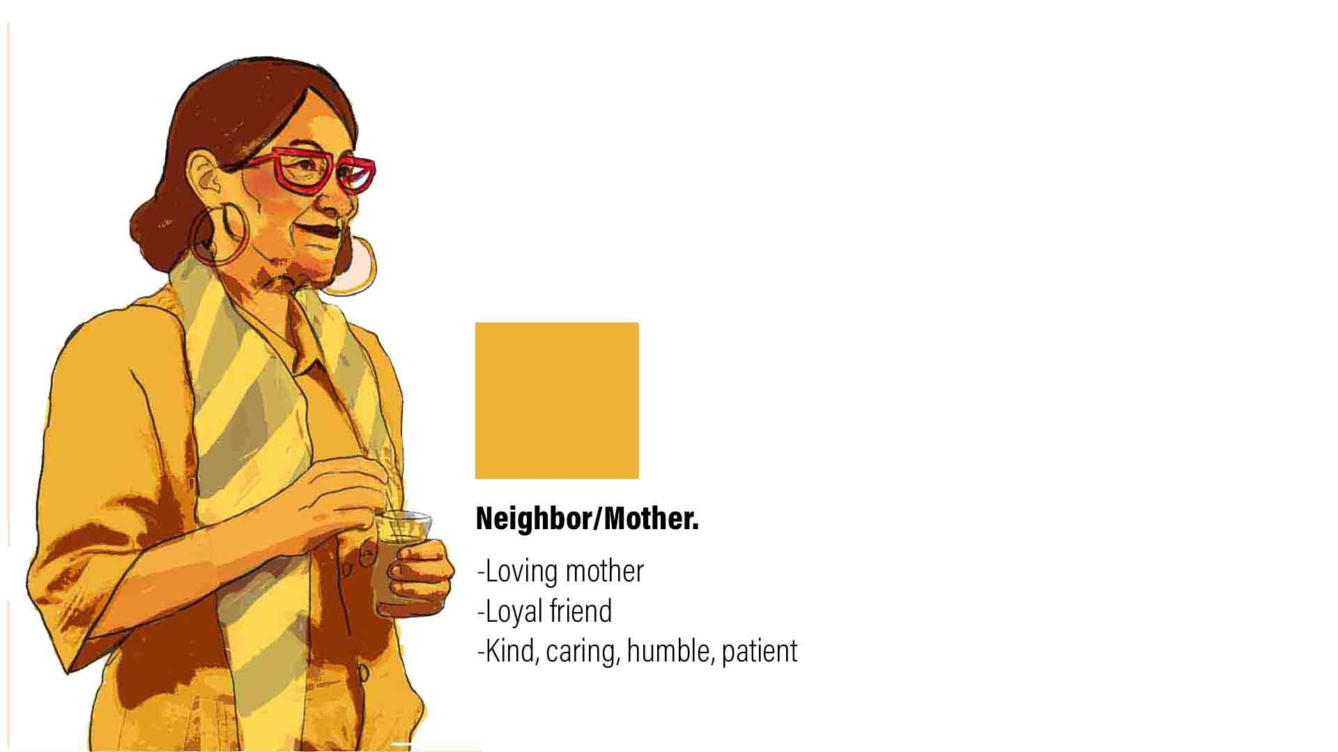
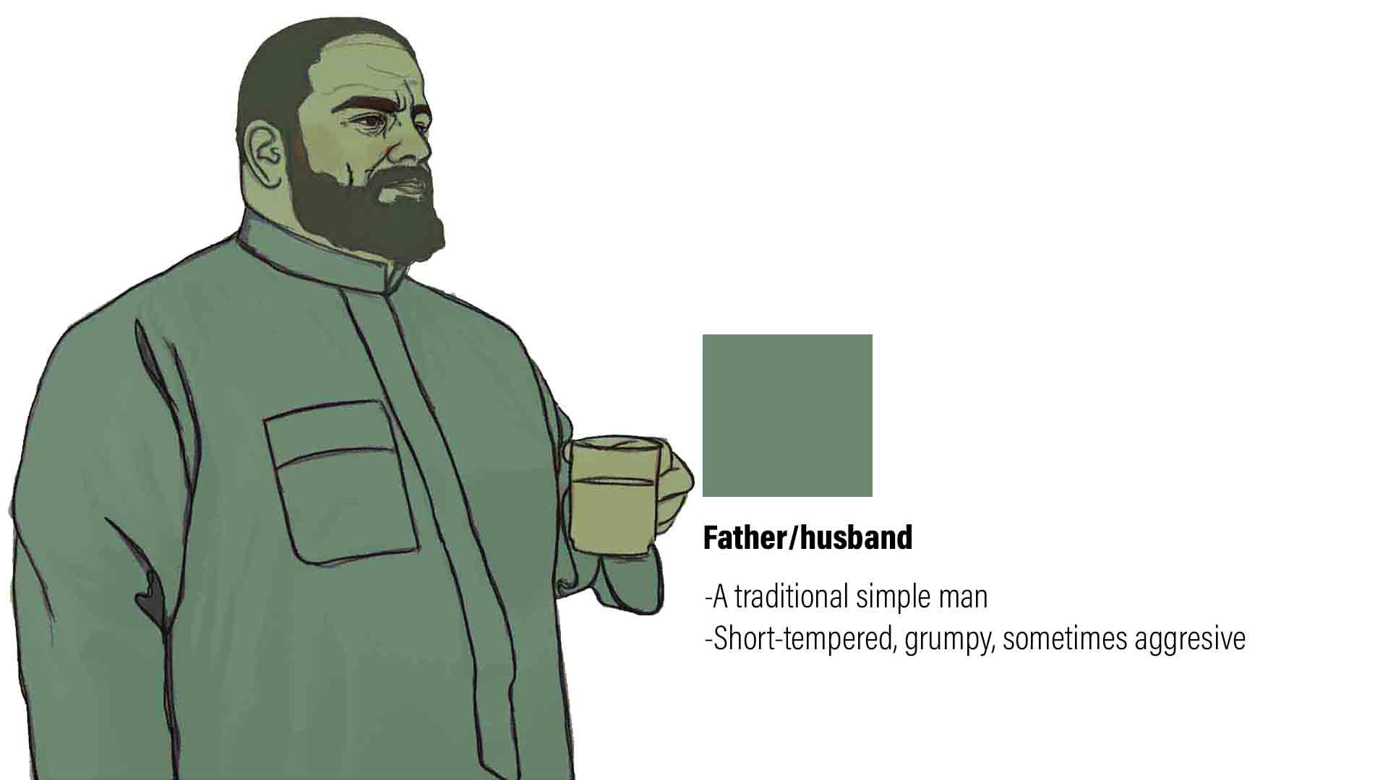
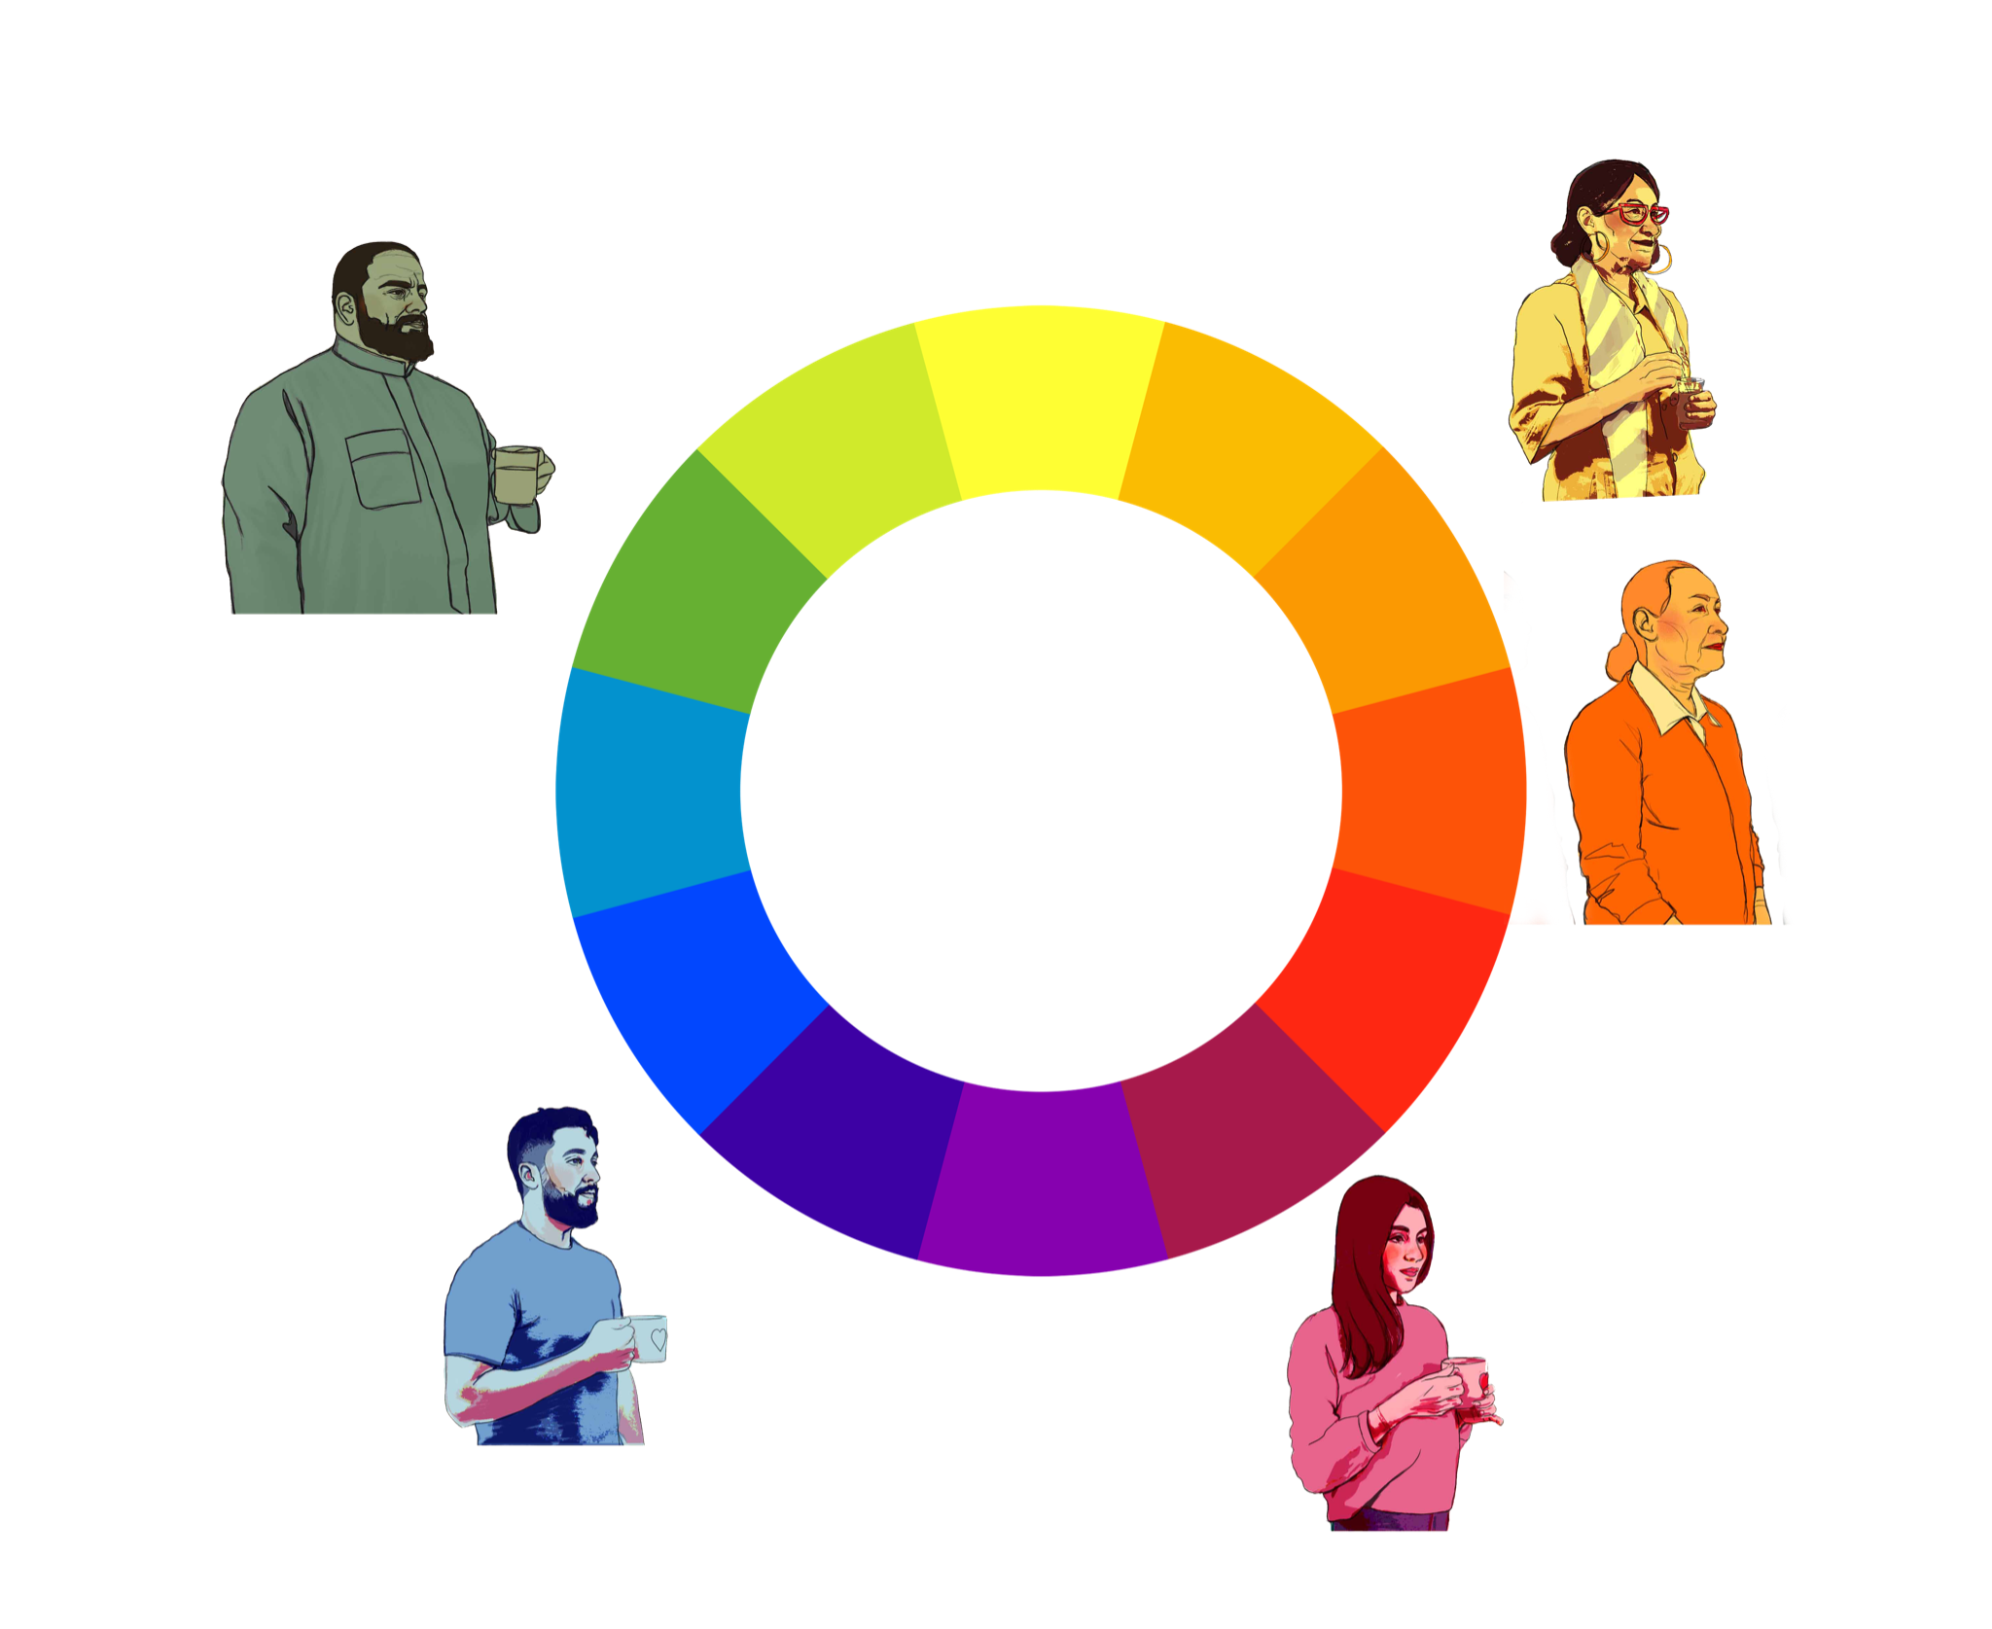
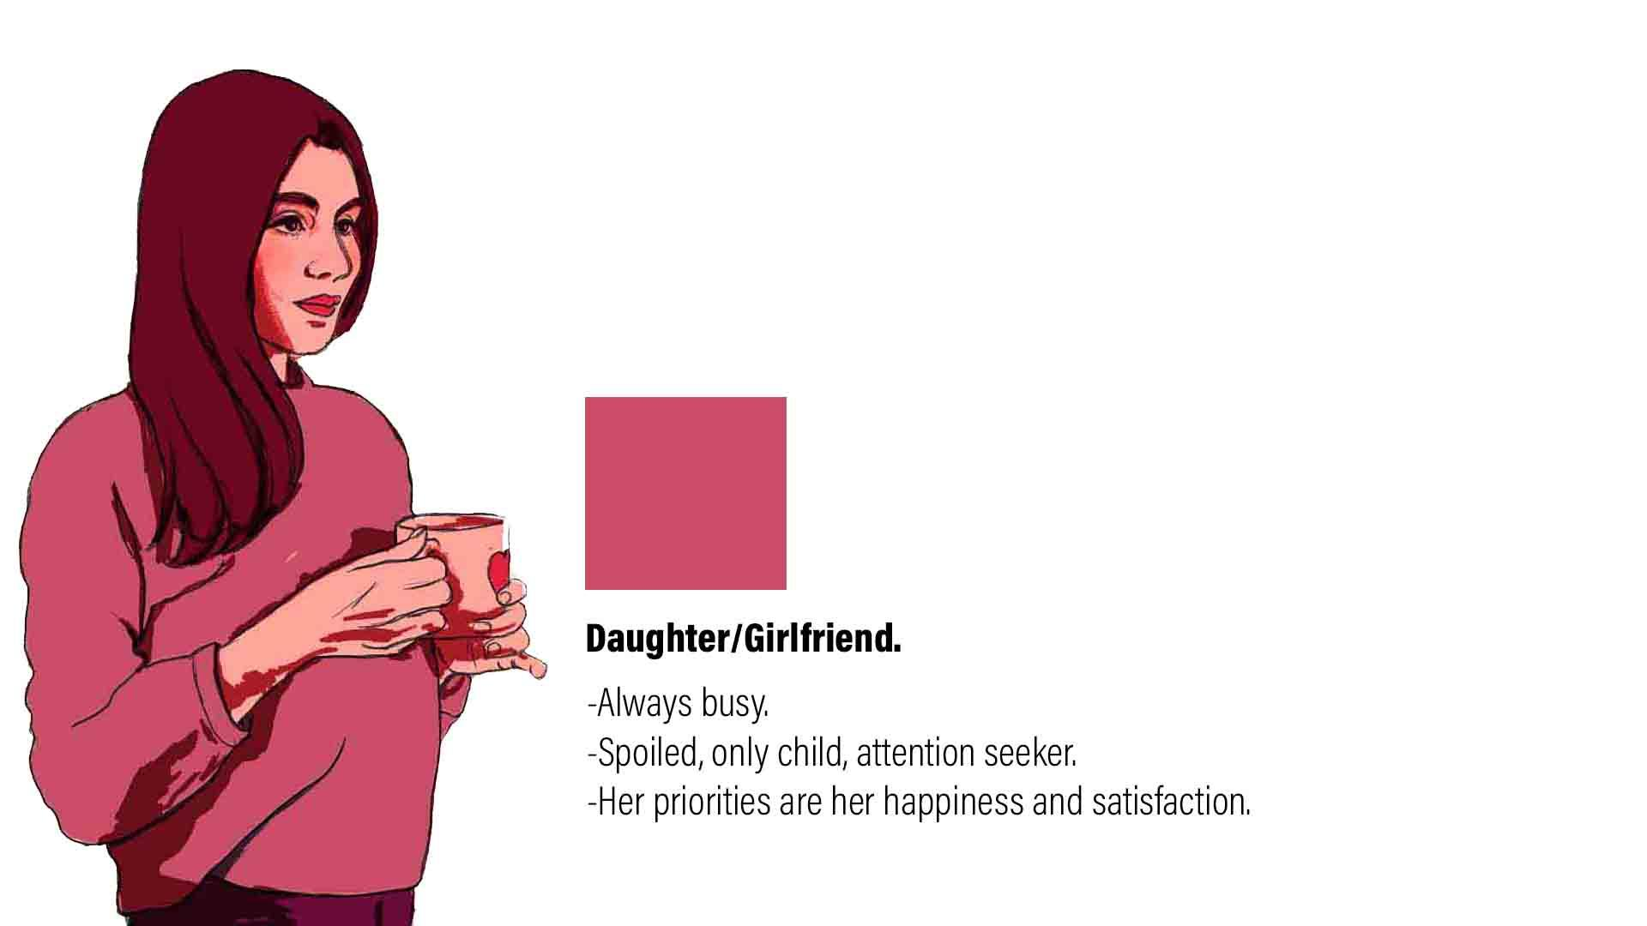
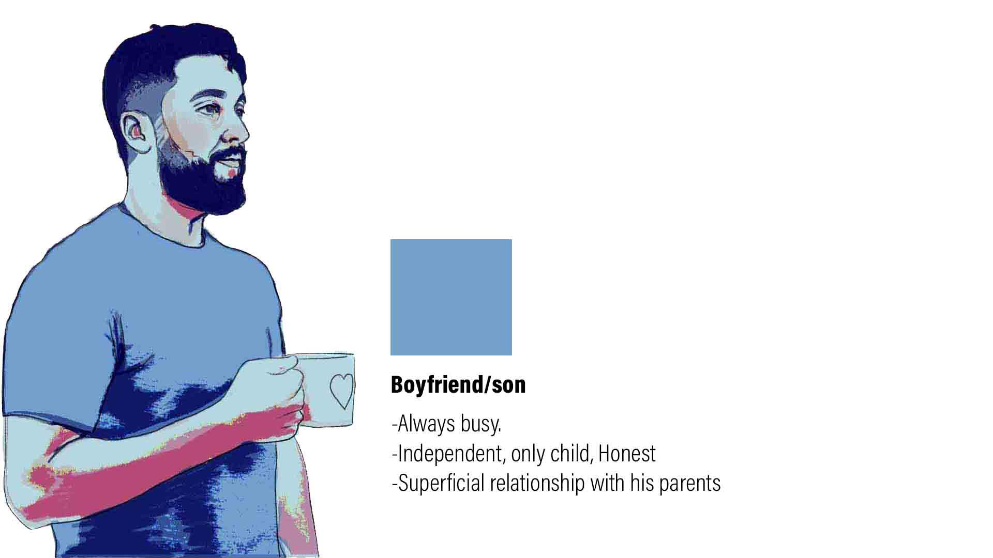
3 -The film itself is a cycle of (interactions, colors, and emotions)
Wife

Slide 9

Platform
Oculus Quest 2
Softwares
(Unity, After Effects, Photoshop, Premiere, Audition )

Slide 10
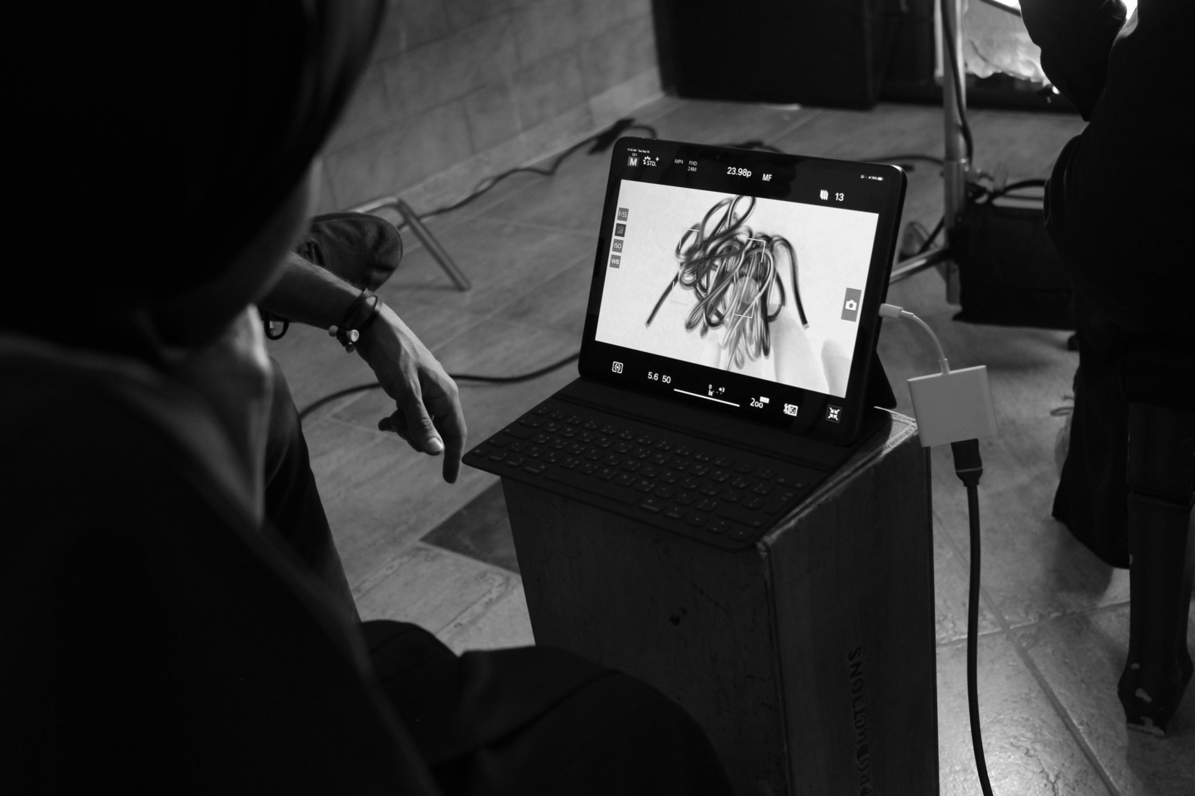
Team Members
Team Members
Raghad Albarqi - Animator / Director
Khawlah Alhalawani - Producer
Editor for 360/ VR film - TBC
Sound Mixer for 360/VR film - TBC

Slide 11

Resources required by Creative Solutions?
Mentoring
Funding

Slide 12
THANK YOU!

